Slide 1

Sinhala and Tamil Language Press Coverage of the Office on Missing Persons (OMP)

Slide 2
Structure
Methodology
Key Findings

Slide 3


Methodology
© Verité Research 2018

Slide 4
Methodology
Transitional Justice and Reconciliation
E.g. UNHRC, OMP, Enforced Disappearances Act, land-related issues, devolution of power, constitutional reforms etc.
Minorities
E.g. Discrimination (issues concerning justice between the state and minorities)
Women
E.g. Electoral quotas, political participation (justice between state and women) etc.

Slide 5
Methodology
How have these been discussed by print media?
Opposing, supporting and neutral
Time period
June – August 2018

Slide 6
Newspapers Monitored
Sinhala Daily/Weekly Newspapers | Tamil Daily/Weekly Newspapers
Lankadeepa | Virakesari / Sunday Virakesari
Divaina | Thinakkural / Sunday Thinakkural
Ada | Thinakaran / Thinakaran Vaaramanjari
Mawbima | Sudar Oli
Dinamina / Silumina | Tamil Mirror
Lakbima
Rivira
Ravaya
Anidda
*Newspapers are in order of readership for the year 2017. For more information see: Media Ownership Monitor Sri Lanka. https://sri-lanka.mom-rsf.org/en/
Notes:
Please make the width of the columns equal and organise newspaper names as per readership data. Please put the state press side by side. Good to follow the same order for our next reports and to explain why we picked these papers

Slide 7
Key Findings
© Verité Research 2018

Slide 8
Finding I omp – parochialism
© Verité Research 2018

Slide 9
OMP – Tamil Language Press
55 in total

Slide 10
OMP – Sinhala Language Press
1 in total

Slide 11
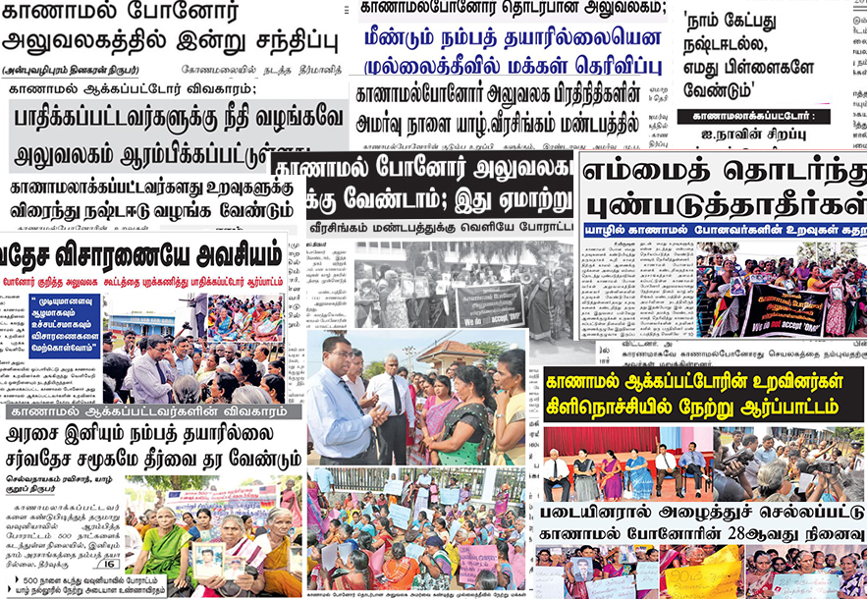
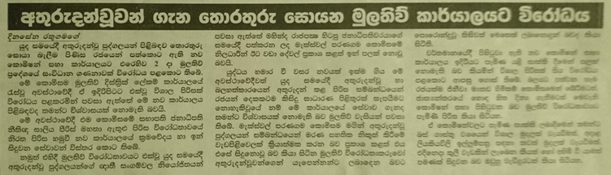
Media Parochialism
55
01

Slide 12
Finding II omp – Protest(er)s
© Verité Research 2018

Slide 13
OMP from the perspective of protest(er)s
Protests in Trincomalee, Mullaitivu and Kilinochchi
Negative sentiment
Progress, international intervention and to halt further testimonials

Slide 14



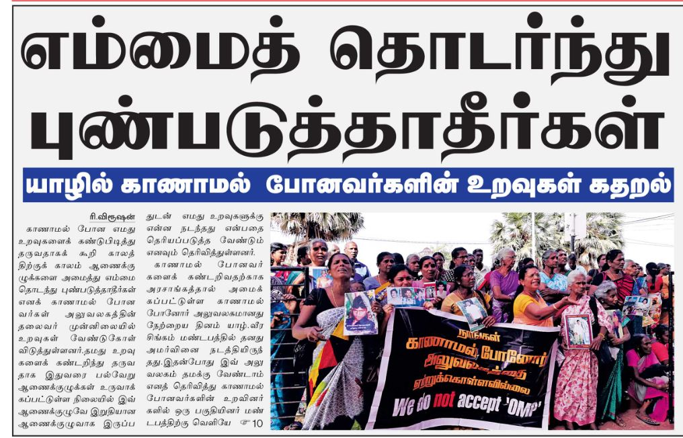
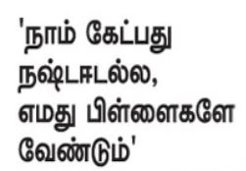
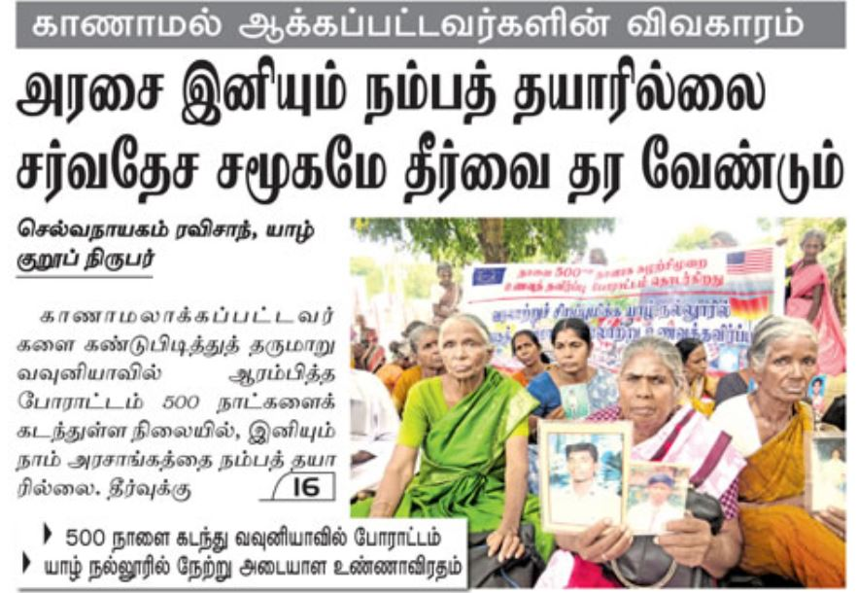

OMP from the perspective of protest(er)s
Thinakaran
Thinakaran Vaaramanjari
Sudar Oli urged the public to re-evaluate its denunciation of the OMP, since this was the only body available at present to aid investigations into enforced disappearances
Sunday Virakesari
“Don’t hurt us anymore: The relatives of the disappeared persons lament in Jaffna”
“We don’t need compensation, we need only our children”
“Affair on missing persons: We are no longer ready to trust the government. The international community should provide the solution”
Sudar Oli

Slide 15
OMP – what is missing?
Limited its focus on protesters
Limited coverage to those supporting the OMP (Canadian High Commissioner, TNA)
Sudar Oli urged the public to re-evaluate its denunciation of the OMP, since this was the only body available at present to aid investigations into enforced disappearances

Slide 16
Finding III omp – Perspective of the Government
© Verité Research 2018

Slide 17
OMP from the perspective of the government
International Truth and Justice Project’s list of 351 disappeared individuals
Tamil press published a media release from the government
Limited to neutral coverage
Politicians calling for reparation

Slide 18

Thank you!

