Slide 1

Media Coverage on Minorities

Slide 2
Structure
Methodology
Key Findings

Slide 3


Methodology
© Verité Research 2019

Slide 4
Methodology
How have these been discussed by print media?
Opposing, supporting and neutral

Slide 5
Time Period
27 October – 30 November 2018

Slide 6
Newspapers Monitored
Sinhala Daily/Weekly Newspapers | Tamil Daily/Weekly Newspapers
Lankadeepa | Virakesari / Sunday Virakesari
Divaina | Thinakkural / Sunday Thinakkural
Ada | Thinakaran / Thinakaran Vaaramanjari
Mawbima | Tamil Mirror
Dinamina / Silumina
Lakbima*
Anidda
Ravaya
* The daily edition of Lakbima announced on 30 November 2018 that it would temporarily suspend its publication

Slide 7
Key Findings
© Verité Research 2019

Slide 8
Finding I
Political SITUATION – parochialism
© Verité Research 2019

Slide 9
Political Situation in Relation to Minorities
Tamil Press
251 in total

Slide 10
Political Situation in Relation to Minorities
Sinhala Press
19 in total

Slide 11
Position of Minorities in the Political Situation
Tamil Minority
Tamil Press on Muslim Minority
Sinhala Press
No Coverage on Muslim Positions in the Sinhala Press

Slide 12
Finding II
Minority problems: Solved or Unsolved?
© Verité Research 2019

Slide 13
Minority Problems Solved?
Discussion led by Thinakaran, Thinakkural and Mawbima
Former President as propelling the rights of the minorities
E.g. TMVP on his support to female headed households
Release of political prisoners
E.g. -Comments by Namal Rajapaksa on imminent release of political prisoners
-UNP’s criticisms of the president on not releasing political prisoners

Slide 14
Minority Problems Unsolved?
Purported appointment of MR as a hindrance to minority justice
President criticised for paving the way for MR
Difficulty in achieving justice under a Sinhala leadership

Slide 15
Finding III position of THE tna
© Verité Research 2019

Slide 16
TNA’s Seats as Political Currency – Tamil Press
TNA as a decisive player
How can it get solutions for Tamils’ grievances?

Slide 17
TNA’s Seats as Political Currency – Tamil Press
Which side should the TNA support?
Maintain a neutral stance
Critical of TNA supporting a NCM
Support Rajapaksa as he could be the “winning side”
International pressure unlike under “Yahapalanaya” government

Slide 18
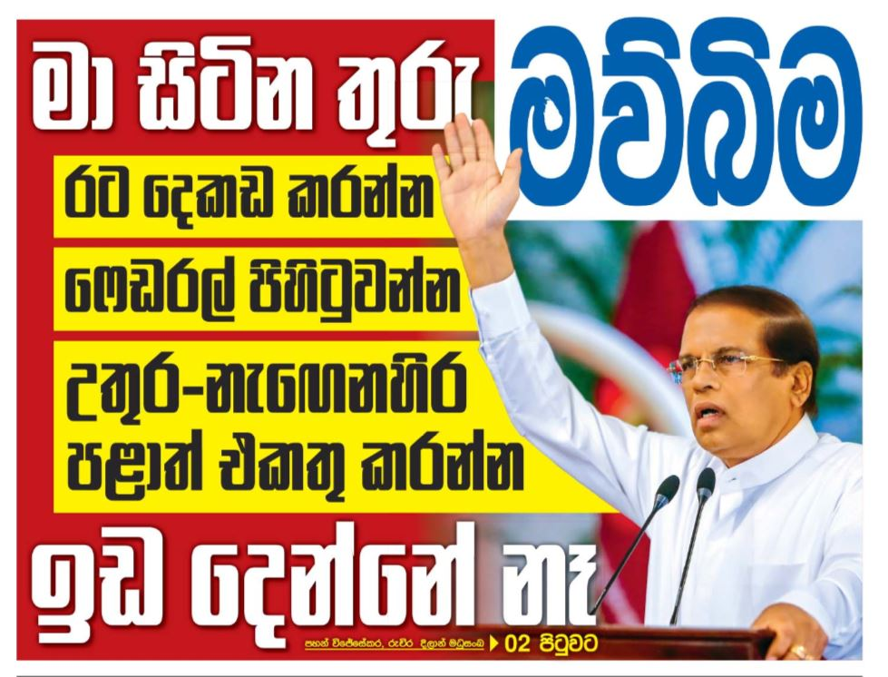
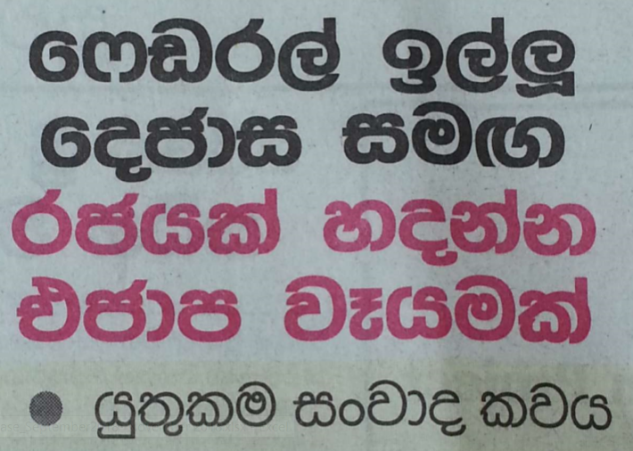
TNA as Detrimental to A Unitary State
Federalism as separatism
“While I am in office I will not allow for the division of the country, establish federalism and the joining of the North and East” – President
“ÜNP is attempting to establish a government with TNA who requested federalism” - Yuthukama Sanwada Kawaya

Slide 19
Finding IV
Position of Muslim Political parties & people
© Verité Research 2019

Slide 20


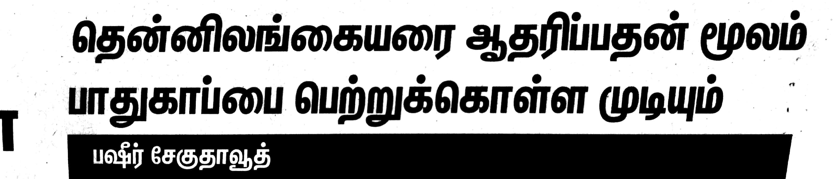
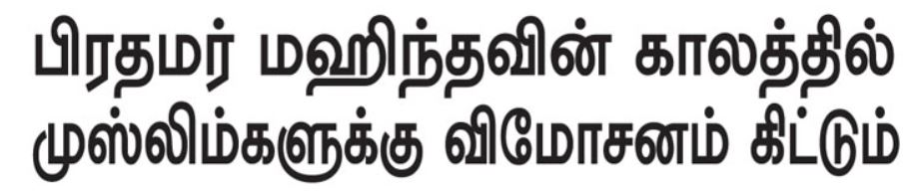
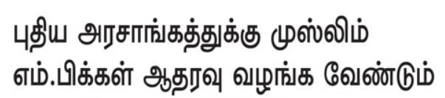
Muslim Political Parties & People
Thinakkural
Thinakaran
“Muslims will get redemption during Prime Minister Mahinda's era”
"Can gain protection by supporting the southern Sri Lankans"- Basheer Saegu Dawood
“Muslim MPs must support the new government”
Sinhala newspapers were silent

Slide 21
Summing up
© Verité Research 2019

Slide 22
Summing up
Parochialism
Position of TNA
Problems of the minorities
Position of Muslim parties and people

Slide 23

Thank you!

